Slide 1
ELECTRIC VEHICLE ANALYSIS
BY G.S.V.DEDEEPYA

Slide 2
PROJECT CONTENTS
Introduction
Data exploration & data cleaning
Loading data
Data visualization
Dashboard presentation
Observations and Recommendations

Slide 3
INTRODUCTION
electric vehicles are the key technology to decarbonise road transport, a sector that accounts for over 15% of global energy-related emissions. Recent years have seen strong growth in the sale of electric vehicles together with improved range, wider model availability and increased performance
Here we analyze the overall landscape of electric vehicles ,encompassing both BEVs and PHEVs, to access the market size and growth. BEV vehicles means Battery Electric vehicles which are working only on electricity .PHEV vehicles means Plugged n Hybrid Electric Vehicles it works on both resources like either on electricity or combustion engines like gasoline or diesel engines

Slide 4
DATA EXPLORATION AND DATA CLEANING
The data given to the project deals with country, city, state, electric vehicle type,model.The dataset has one csv file. This file have 17 fields and 150482 records .file name is electric vehicle population data.
In preparing our dataset for analysis, the first crucial step involved meticulous data cleaning to ensure the integrity and relevance of the information. Here are the key actions taken:
Removing Duplicate or Irrelevant Observations: Duplicate entries and irrelevant observations, such as VIN(1-10) , Legislative district ,electric utility were identified and systematically removed from the file. This process aimed to streamline the dataset, keeping only the essential information for our analysis.
Handling Empty (Null) Values: Null values in specific columns, including base MSRP were addressed. To maintain the dataset’s completeness and accuracy, records with null values in these columns were removed.
These data cleaning steps were crucial in ensuring that the dataset used for subsequent analysis was free from redundancies, irrelevant information, and missing values, setting the stage for a more accurate and insightful examination of the chosen key performance indicators

Slide 5
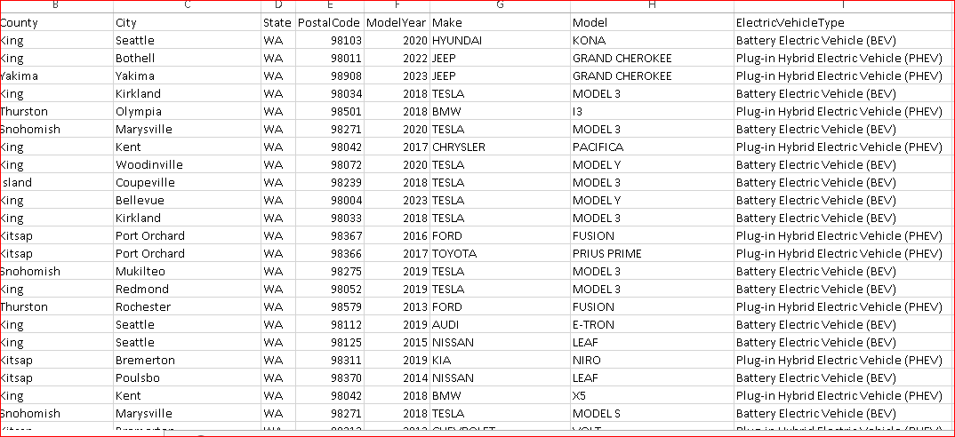
After cleaning the data files is as shown below

Slide 6
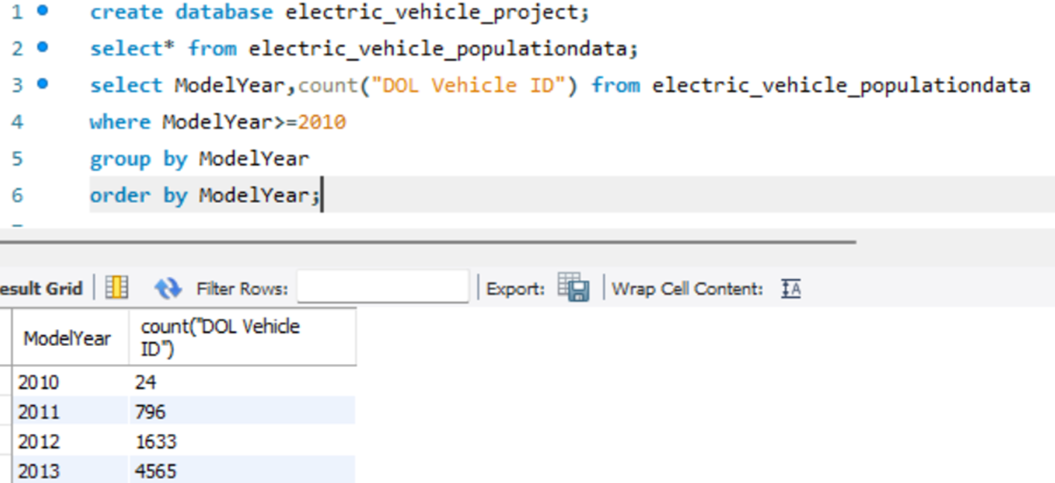
DATA VISUALIZATION Total vehicles by model year
Here we can see that usage total vehicles are increasing year by year.in 2024 it shows only 642 vehicles only because we are in this year. this data taken upto February month. This sign will lead to adapting green energy.
Recommendations:
The people should have subsidy on these electric vehicles to increase sales more and more.

Slide 7
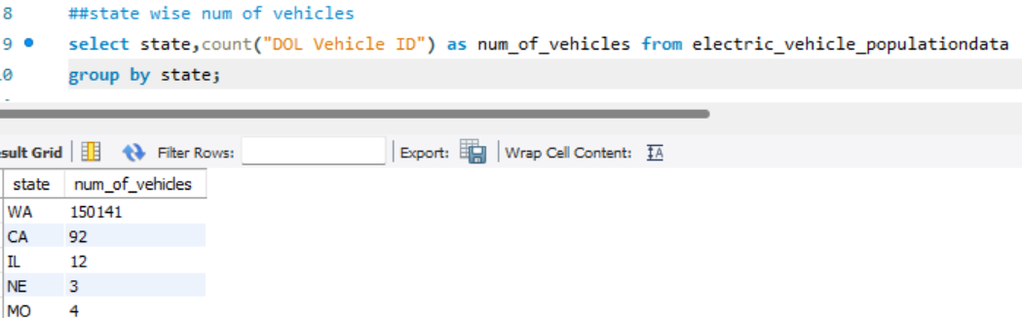
Total vehicles by state
This chart will showcase the geographical distribution of electric vehicles across different states, allowing for the identification of regions with higher adoption rates.
Here we observed that WA state ha more number of electric vehicles
Recommendations:
There is need to focus on states those have least electric vehicles and implement awareness programs on pollution.

Slide 8
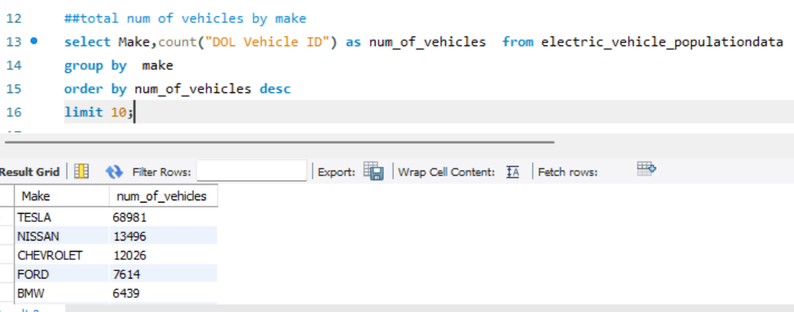
Total vehicles by make
Here we highlight the top 10 vehicles by manufacturers based on total number of vehicles.

Slide 9
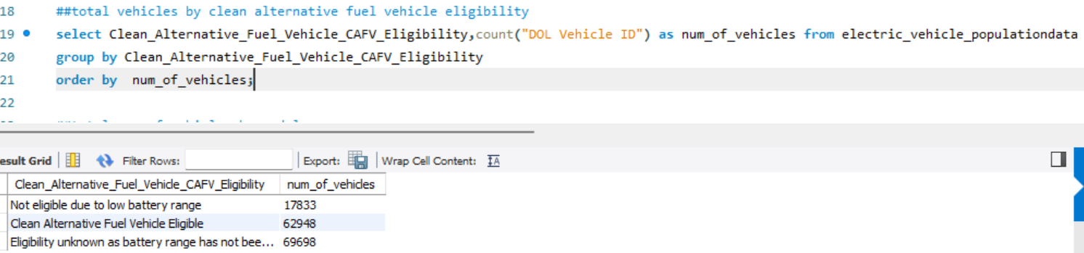
Total vehicles by (CAFV Eligibility)
Here it shows the proportion of electric vehicles that are eligible for clean alternative fuel vehicle(CAFV) incentives, aiding in understanding the impact of incentives on vehicle adoption. It divided into three categories. Coming to Eligibility unknown as battery range has not been researched.in this category research is still going on.
clean alternative fuel vehicle eligible giving us clean energy vehicle.it is nonpolluting vehicle.
The research is still going on not eligible due to low battery range.

Slide 10
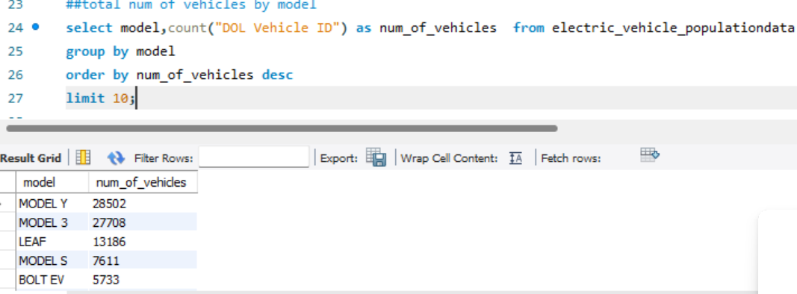
Total vehicles by model
Here we highlight the top 10electric vehicle models based on the total number of vehicles, offering insights into customer preferences and popular models in the market.

Slide 11
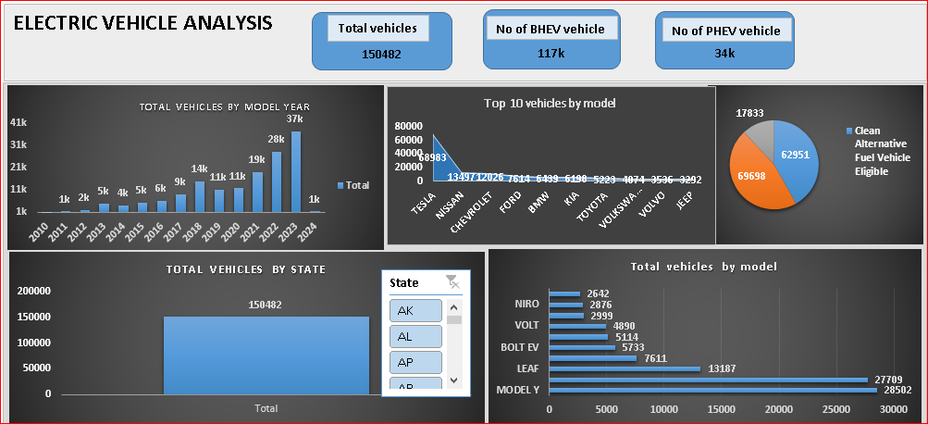
Screenshot of excel dashboard

Slide 12
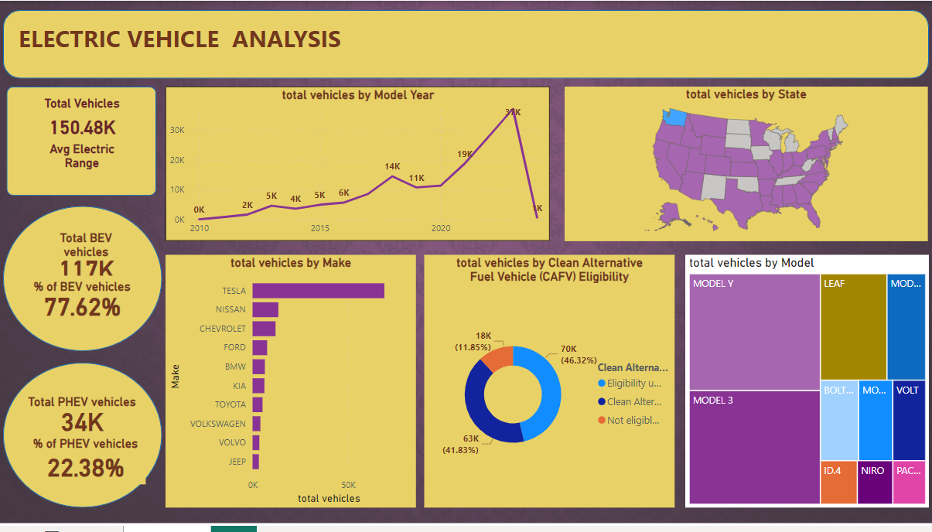
Screenshot of power bi dashboard

Slide 13
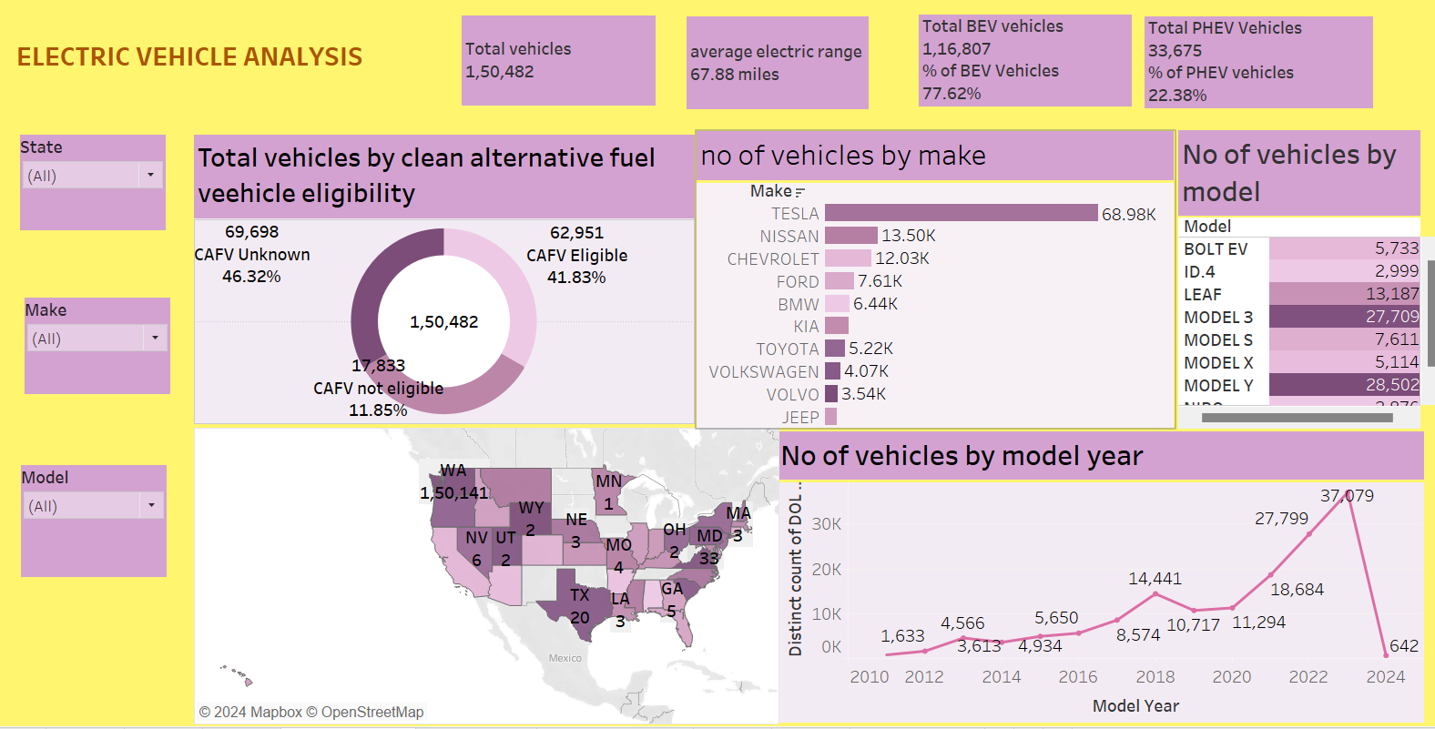
Screenshot of tableau dashboard

Slide 14
What I learn
Importance of key performance indicators in data analytics.
How all these parameters are extracted from data to make Pivot tables, charts and beautify interactive and mesmerizing dashboards in Excel, Power BI and Tableau using slicers, filters, icons and images. Writing queries for the same in SQL.
CHALLENGES DURING PROJECT:
True challenge was to assemble our classroom knowledge and to put it into this real-world situation.

Slide 15
THANK YOU

